Slide 1
TPLinker: Single-stage Joint Extraction of Entities and Relations Through Token Pair Linking
Code：https://github.com/131250208/TPlinker-joint-extraction
王景慧
2021.4.11

Slide 2
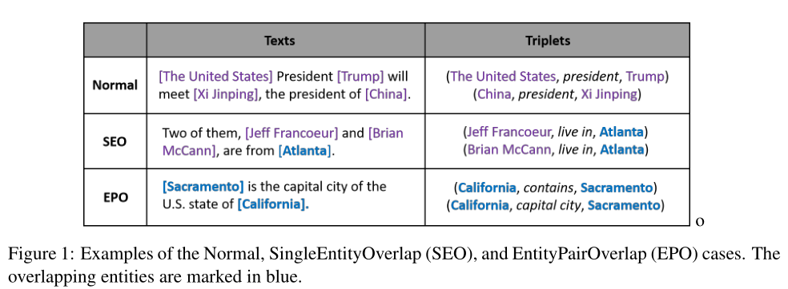
Motivation

Slide 3
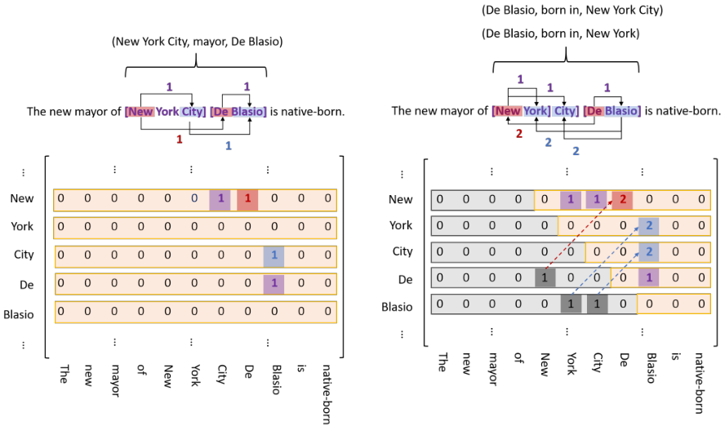
Method
Figure 2: (Best viewed in color.) Left: A tagging matrix. For the convenience to illustrate, we show all
tags in one matrix, in which each color corresponds to a specific kind of tag. Right: An example of the
Handshaking Tagging Scheme, the region in shade is not included in the tag sequence.

Slide 4
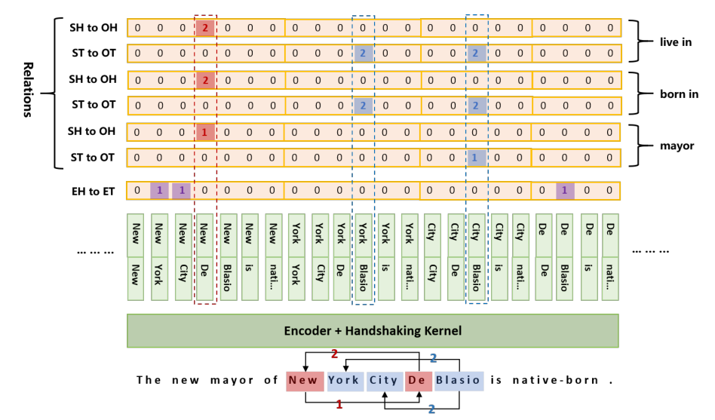
Method
Figure 3: The Framework of TPLinker. SH is short for subject head, OH is short for object head, ST is short for subject tail, and OT is short for object tail. By decoding, 5 triplets can be extracted: (New Y ork,mayor, De Blasio), (De Blasio, born in, New Y ork), (De Blasio, born in, New Y ork City), (De Blasio,live in, New Y ork), (De Blasio, live in, New Y ork City).

Slide 5
Method

Slide 6
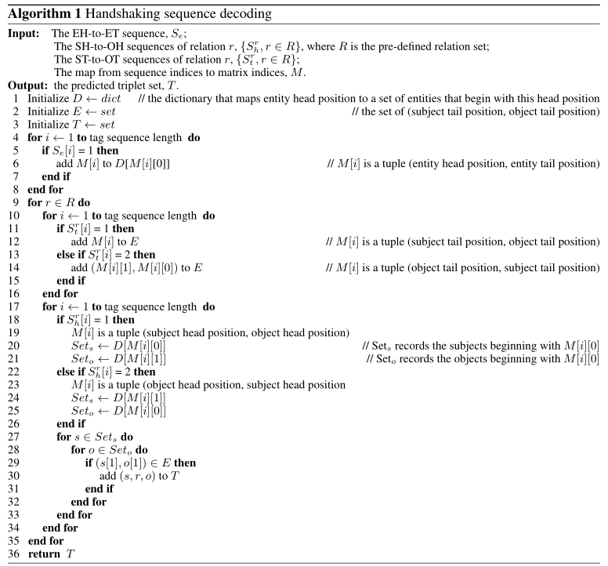

Slide 7
Experiments

Slide 8
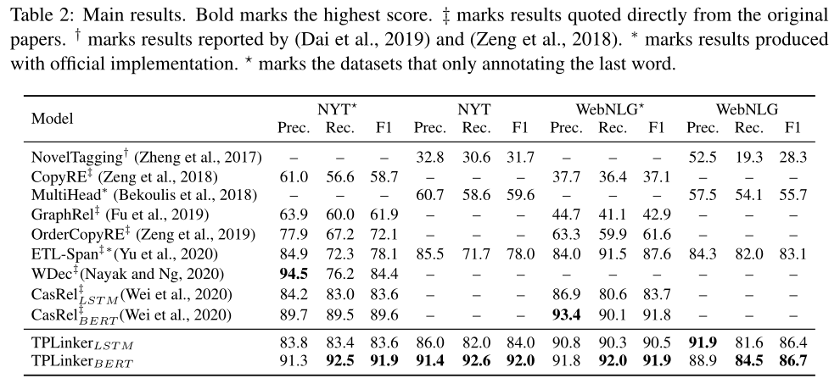
Experiments

Slide 9
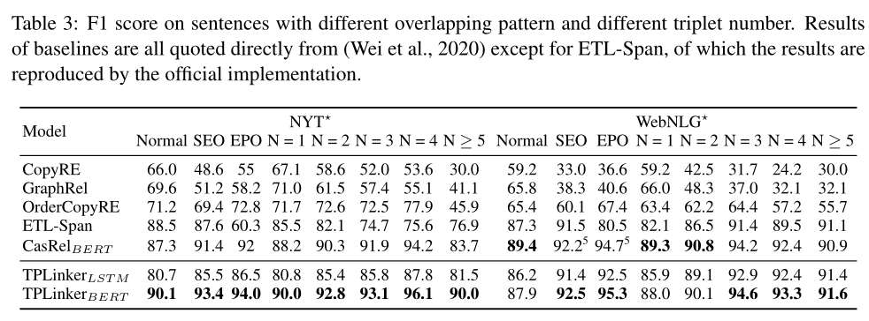
Experiments

Slide 10
Experiments

Slide 11
THANK. YOU

